Slide 1
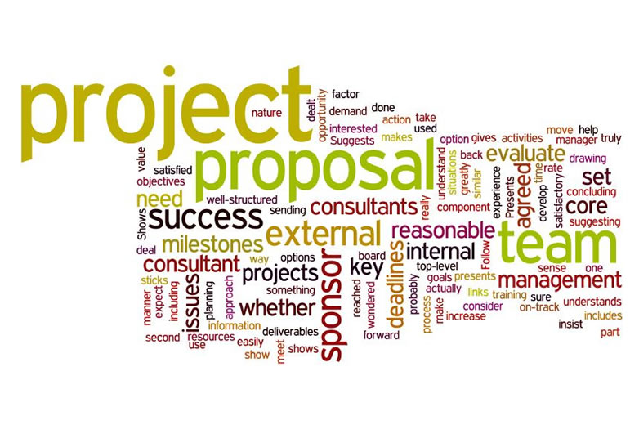
Adobe Flash Project Proposal
Jake Lorah

Slide 2
Company Name
JLor Studios

Slide 3
Background/About Us
I have been the owner of this company for 5 years now.
Our company creates clean and interesting animations.
We make animations for anybody or anything!
We focus on quality, not quantity.

Slide 4
Problem/Solution
We must make two Adobe Flash animations.
One for a Christmas gift card.
Another to promote the iPhone X.
We are going to use our knowledge with Adobe Flash to make this happen.

Slide 5
Scope of Work
Our client wants the following criteria to be met:
Minimum of 15 Seconds (iPhone X animation).
Motion and Shape Tween (iPhone X animation & Christmas gift card animation).
3D effects (Christmas gift card animation).
Mask Effect (iPhone X animation).
Inverse Kinematics (Christmas gift card animation).
Movie Clips within a movie (iPhone X animation).
Custom Buttons with Play, Start, or etc.... for at least one animation (iPhone X animation).
Sounds (iPhone X animation & Christmas gift card animation).

Slide 6
Fees/Cost
We charge $30 per hour of work.
We will work on this for a total of 5 hours.
The total fee of both animations will be $150.

Slide 7
Terms and Condition
By using JLor Studios to complete your task, you hereby agree to pay the full amount of $150 right after we submit the final product to you. Along with that, you must grade the final product based on what is stated in the lecture slides.
I, Mr/Mrs________________, approve the Adobe Flash Project Proposal from JLor Studios.

